Slide 1
Introduction
Tawk.to is a live chat support & messaging application that focuses on successful communication between businesses and their clients.
Modern and intuitive, Tawk.to was created to help find an efficient way to bridge the communication gap between clients and businesses.
Aside from its live chat service, Tawk.to offers a whole lot of other features like full customization of the chat window, start lively chats with potential clients, eagerly engage with visitors using triggers, quickly send replies with shortcuts to help agents and businesses become a hit with valued customers.

Slide 2


Live chat support & messaging application

Slide 3

WHAT IS TAWK.TO
Tawk.to is a live chat support & messaging application that focuses on successful communication between businesses and their clients.
Modern and intuitive, Tawk.to was created to help find an efficient way to bridge the communication gap between clients and businesses.
Aside from its live chat service, Tawk.to offers a whole lot of other features like:
full customization of the chat window.
start lively chats with potential clients, eagerly engage with visitors using triggers.
quickly send replies with shortcuts to help agents and businesses become a hit with valued customers.
Inside communication between agents.
Analytics and ticket generation for follow up.
Getting real time location of customers / client.

Slide 4
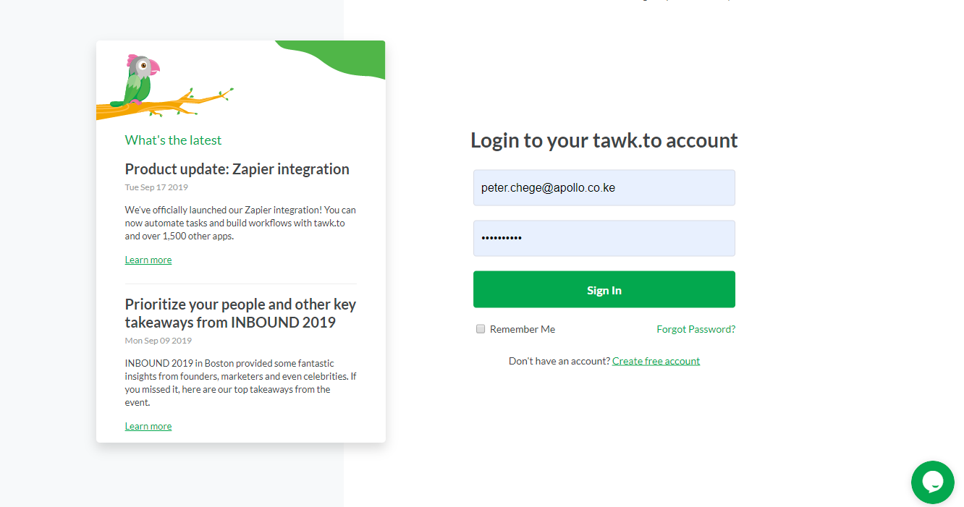
GETTING STARTED
STEP ONE : ACCOUNT CREATION
Administrators will be pre-registered by the developers on the platform.
The admin will register the desired agents by filling in their credentials.
The agent / customer service will recieve an invite in their email.
Once you have accepted the invited you will be promt to create your password.
The next step is to login, then you are ready to go.

Slide 5
Getting Started
Account Creation
Administrators will be pre-registered by the developers on the platform after which they will invite their desired agents to manage the site dashboard.
tawk.to is an Agent Centric chat application, which means every agent has their own account and can share Properties.
Currently there are two properties: sites and pages.
Sites – refer to websites where the chat widget is embedded
Pages – refer to the tawk.to hosted pages e.g. https://apainsurance.org/commercial.php

Slide 6
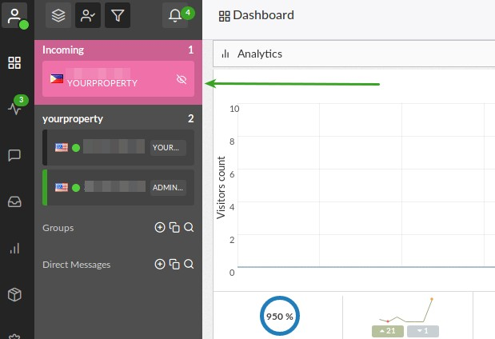
GETTING STARTED: DASHBOARD
STEP TWO: INCOMING CALL
When someone visits the APA website and initiates a chat using the live chat widget, agents will hear a notification sound.
On the left side of the dashboard they will see that the visitor and the background color will be PINK. That indicates the agent has an incoming chat that needs to be answered.

Slide 7
Using the Dashboard
Answering incoming chats
When someone visits the APA website and initiates a chat using the live chat widget, agents will hear a notification sound.
On the left side of the dashboard they will see that the visitor and the background color will be PINK. That indicates the agent has an incoming chat that needs to be answered.

Slide 8
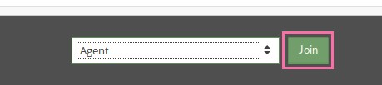
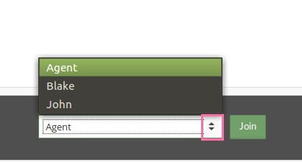
GETTING STARTED: DASHBOARD
STEP TWO: ANSWERING INCOMING CALL
To Answer, an agent will click on the visitor (with PINK background) and a chat window will open. There are various chat answer background colors:
PINK Background – New incoming chat that has not been answered.
GREEN Bar – Chat that has already been answered and is currently active.
GRAY Bar – Chat that is active but ANOTHER agent has answered.
The agent will then click on the JOIN BUTTON at the bottom of the chat window. Once answered, the visitor chat area will have a green background.

Slide 9
Using the Dashboard cont…
To Answer the incoming chat, an agent will click on the visitor (with PINK background) and a chat window will open. There are various chat answer background colors:
PINK Background – New incoming chat that has not been answered. GREEN Bar – Chat that has already been answered and is currently active. GRAY Bar – Chat that is active but ANOTHER agent has answered.
The agent will then click on the JOIN BUTTON at the bottom of the chat window. Once answered, the visitor chat area will have a green background.
The agent can also use the menu to select which Alias they would like to join the chat with. The Alias names will appear when the dropdown menu is clicked.

Slide 10
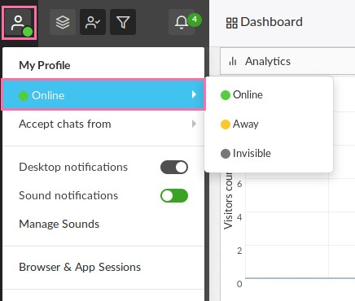
Using the Dashboard cont…
Online, Away and Invisible agent status
An agent can set either of the above status.
Online Status – Agent is online and available to answer incoming chats.
Away Status – Agent is online and available to answer chats but has set the widget message to say “Away” to set the visitors expectation that the agent may or may not be available to answer their chat.
Invisible Status – Agent is offline but can see chats in the tawk.to dashboard but can’t join them. This status should only be used to monitor chats.
Status is changed by navigating to the top right of the tawk.to dashboard and using the drop down menu.

Slide 11
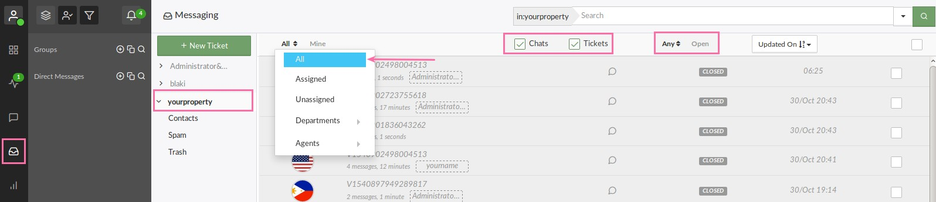
Using the Dashboard cont…
Viewing Chat History
History for any chat can be viewed by clicking on the Messaging icon on the Left Sidebar of the Dashboard.
From the list on the left an agent can click on the name of the Site, tawk.to Page or Profile Page they wish to view past messages from. Then click ALL on the left of the message view area.
Closed chats, missed chats and tickets can all be seen in this area. They can be sorted by Open, Pending or Closed.

Slide 12
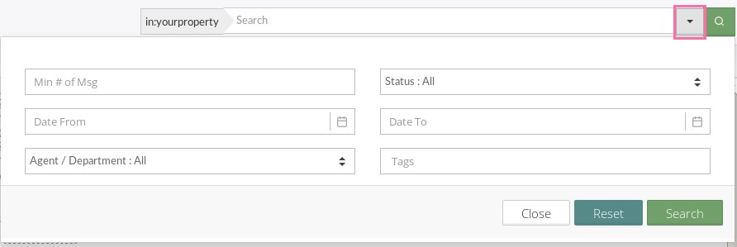
Using the Dashboard cont…
Viewing Chat History cont…
Miss chats can be viewed quickly by selecting Unassigned as a filter.
Clicking on a message in the list of messages will open a window where an agent can view the chat transcript or ticket as well as other details such as :
Visitor location
Ip address
Notes
Last visit etc.
The search box above the messaging section can be used to quickly find a chat or ticket.

Slide 13
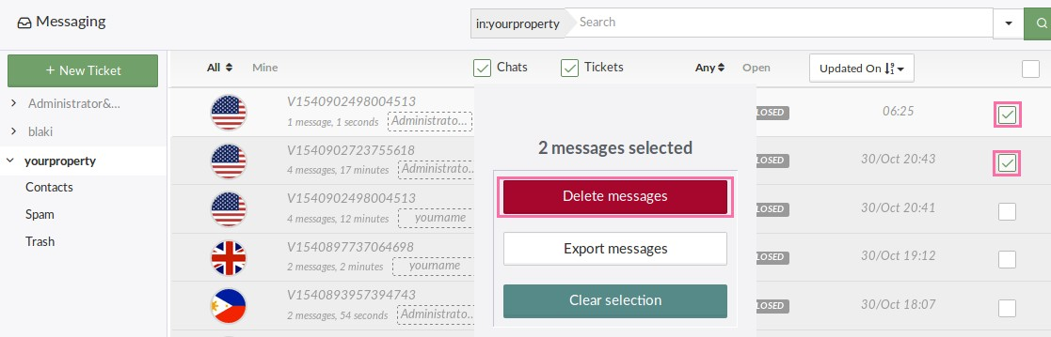
Using the Dashboard cont…
Viewing Chat History cont…
To Delete a Chat or Message from History simply check the box on the right side of the list next to the message you wish to delete. You can delete multiple messages at once or one at a time. Just check the box and then click on the red delete messages button. You must be an Admin to delete messages in history.

Slide 14
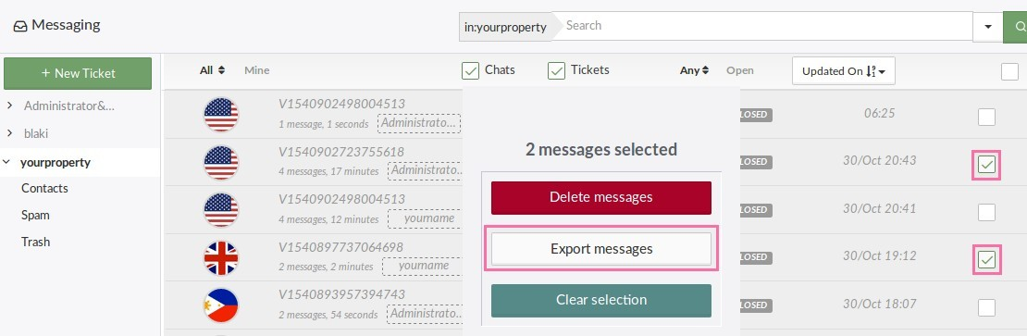
Using the Dashboard cont…
Viewing Chat History cont…
To Export a Chat or Message from History simply check the box on the right side of the list next to the message you wish to export. You can export multiple messages at once or one at a time. Just check the box and then click on the export messages button. You must be an Admin to export messages in history.

Slide 15
Using the Dashboard cont…
Using Messaging and Ticketing

Slide 16
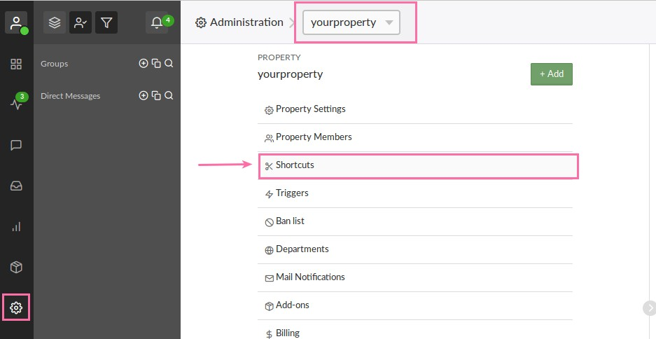
Using the Dashboard cont…
Creating and managing shortcuts
Agents can create and use Shortcuts (canned responses) to answer common questions by simply typing / followed by a keyword. E.g. an agent could type /hello to quickly send the visitor the text: “Hello how can we help you today?”
To create a New Shortcut, click on Admin at the Top of the Dashboard and then click on Shortcuts.

Slide 17
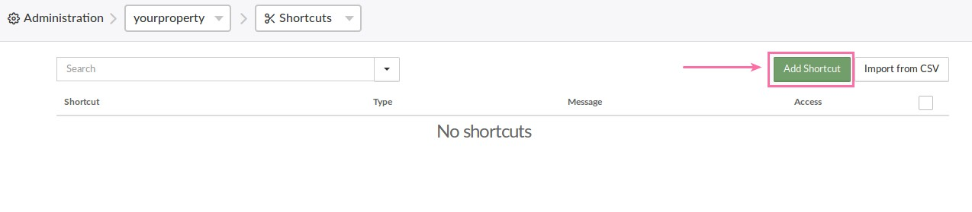
Using the Dashboard cont…
Creating and managing shortcuts cont…
Then Choose the Property the Shortcut will be used for.
Click on Shortcuts and you will see a screen like the image below. You can Manage Existing Shortcuts here.
Click the Green Add Shortcut Button at the Top Right of this screen to Add a New Shortcut

Slide 18
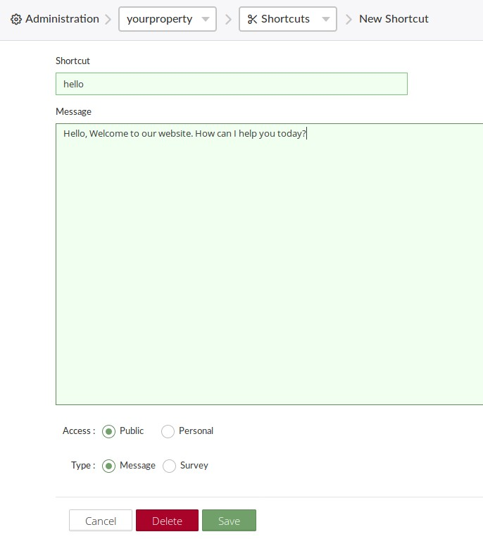
Using the Dashboard cont…
Creating and managing shortcuts cont…

Slide 19
Using the Dashboard cont…
Creating and managing shortcuts cont…
When naming a Shortcut, THE FORWARD SLASH “/” should not be included and it should be all lower case.
Creating a shortcut involves:
1. Name the Shortcut 2. Enter the Message you want to send the visitor for that Shortcut 3. Choose whether this Shortcut is Personal (only you can see and use it) or Public (any agent can use it) 4. Choose whether this Shortcut is a message or a quick survey. (it will almost always be a message)

Slide 20
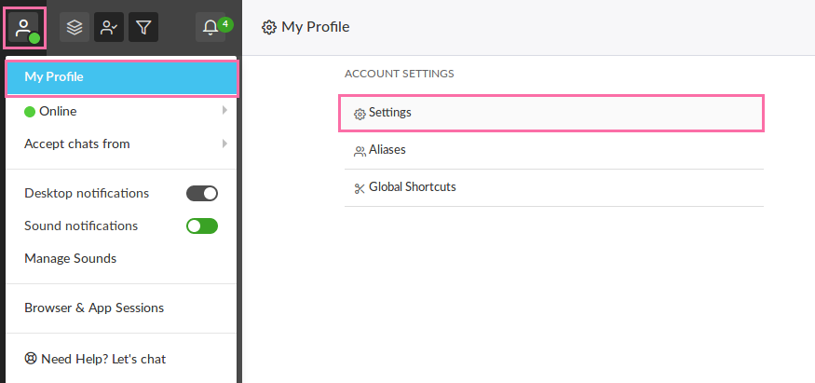
Using the Dashboard cont…
Editing tawk.to account settings
To Edit the Account Settings, navigate to the Top Left corner of the Dashboard. Click on the icon for My Profile then on the Settings option under Account Settings

Slide 21
Using the Dashboard cont…
Editing tawk.to account settings cont…
Settings that can be changed include the Name, Email and the Password for the Tawk.to account.

Slide 22
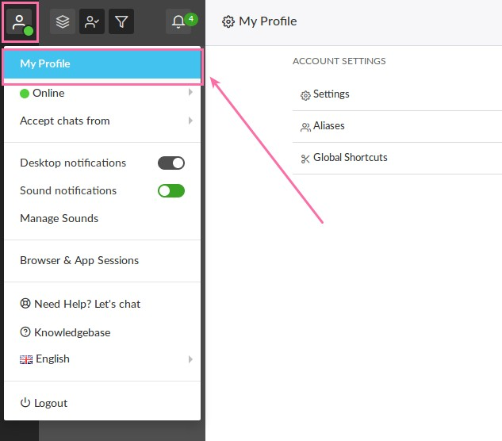
Using the Dashboard cont…
Creating and managing aliases
A user can have multiple aliases, so he or she can answer each chat with any name they like. To Manage Aliases:
Log-in to Dashboard
Go to My Profile (top left corner of the dashboard)

Slide 23
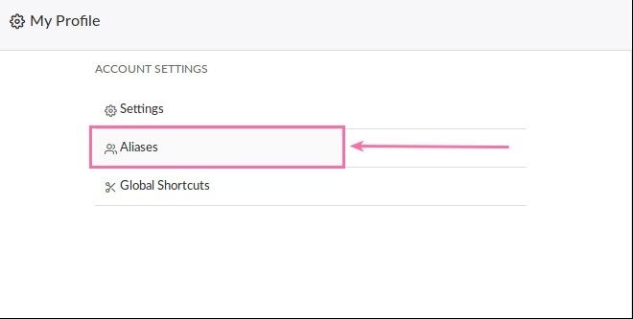
Using the Dashboard cont…
Creating and managing aliases cont…
Navigate to Aliases under Account Settings.

Slide 24
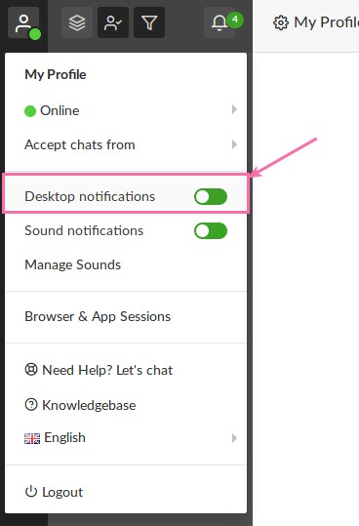
Using the Dashboard cont…
Enabling desktop notifications
These will appear even if the web browser is minimized.
Steps to enable:
Go to the Top Left of the Dashboard and click on the My Profile Icon.
Switch Desktop Notifications On or Off.

Slide 25
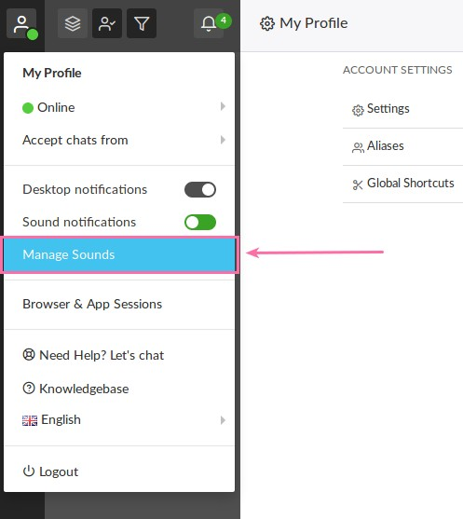
Using the Dashboard cont…
Managing sound settings
To Change the Sound settings in the Dashboard:
Go to the Top Right of the Dashboard and click on the Settings Icon. (Gear Icon)
Go to Manage Sounds.

Slide 26
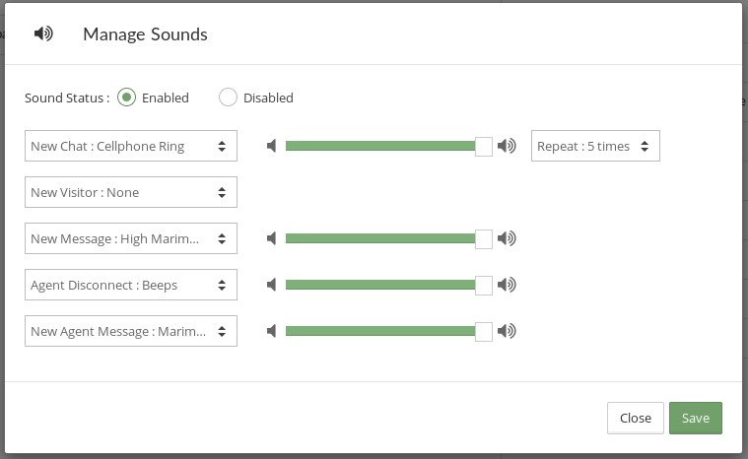
Using the Dashboard cont…
Managing sound settings cont
Choose the Sound you would like to use for each Action.
Set the Volume Level and how many times you would like that Sound Repeated
Click Save

Slide 27
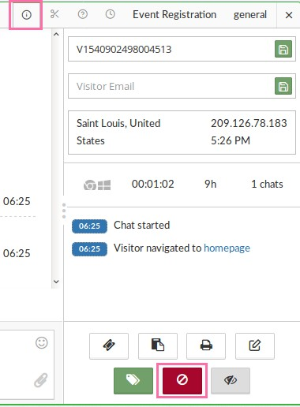
Using the Dashboard cont…
Banning a visitor
If there’s a visitor that needs to be banned from using the chat widget, a user can use the following steps.
If user is in an active chat:
Go to the Options menu in the top right corner of the chat window. Click Details to bring up the Details Pane if it’s not already open.
Click Ban Visitor. Provide a reason for Banning the Visitor.

Slide 28
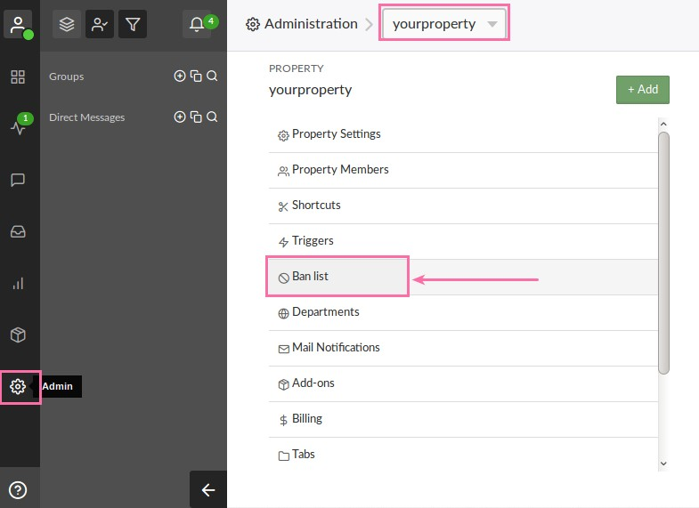
Using the Dashboard cont…
Banning a visitor cont
A user can choose to Ban the visitor by IP address by selecting the Ban IP box. (If this isn’t done, the visitor will be able to clear the cookies in their browser and return)
If not in an active chat:
Navigate to top of the Dashboard and click on Admin. Then under Property settings click Ban List.

Slide 29
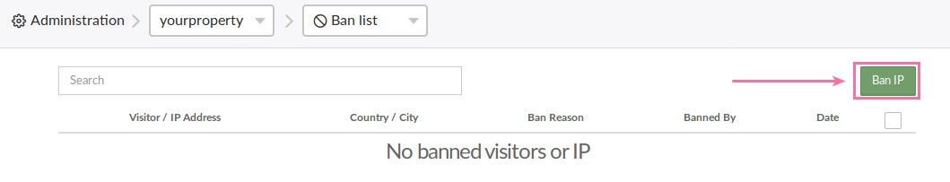
Using the Dashboard cont…
Banning a visitor cont
There will be a Green button that says Ban IP at the Top Right of that screen. A user can enter the IP address for the visitor and create the ban.
To Remove a Banned Visitor from the Banned Visitor list click the empty box to the right of that visitor. A Delete Button will appear. Click the Delete Button to remove the ban.

